Slide 1
30/11/2013
Grade B
Reverse Percentages
Mathanagrams!
e.g. hstma = maths
ncpeetrgea
eredge
niums
lcecir
ebuc
Can you come up with your own?!
percentage
degree
minus
circle
cube

Slide 2
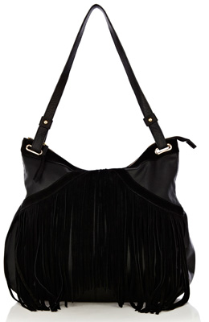
Reverse Percentages
There is a 20% sale on in Topshop.
The bag I want is now £60.
What was the original cost of my bag?
Discuss with your partner and answer on your mini white board.
1)What does £60 represent as a percentage?
2)Can you think of any ideas on how
you would find out how much
it cost before the sale?

Slide 3
There is a 20% sale on in Topshop.
The bag I want is now £60.
What was the original cost of my bag?

Slide 4
In a sale, everything is reduced by 30%
If an armchair costs £175 in the sale,
what was its price before the sale ?
175
%
%
%

Slide 5
A mouse increases its body weight by 15%
If it now weighs 368g, what was the mouse’s original weight ?
368
%
%
%

Slide 6
A shop has a sale with 30% off everything. A jumper costs £21 in the sale. How much did it cost before the sale?
Pupil A works out the answer as £27.30
Pupil B works out the answer as £30
Which one is correct?

Slide 7
5 | 0 | 9 | 2 | 8 | 6
7 | 1 | 7 | 3 | 2 | 0
6 | 1 | 6 | 5 | 5 | 0
1 | 2 | 8 | 9 | 1 | 3
0 | 5 | 3 | 0 | 2 | 4
6 | 2 | 4 | 2 | 5 | 3
4 | 0 | 0 | 0 | 2 | 1

Slide 8
